Slide 1

MPI
Sapna Arora
Assistant Professor
PIET(ECE)

Slide 2
Instruction Set of 8086
An instruction is a binary pattern designed inside a microprocessor to perform a specific function.
The entire group of instructions that a microprocessor supports is called Instruction Set.
8086 has more than 20,000 instructions.

Slide 3
Classification of Instruction Set
Data Transfer Instructions
Arithmetic Instructions
Bit Manipulation Instructions
Program Execution Transfer Instructions
String Instructions
Processor Control Instructions

Slide 4
Data Transfer Instructions
These instructions are used to transfer data from source to destination.
The operand can be a constant, memory location, register or I/O port address.

Slide 5
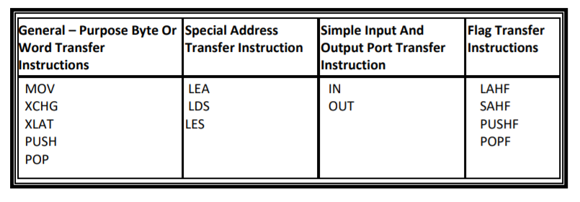
Data Transfer Instructions

Slide 6
MOV
MOV Des, Src:
Src operand can be register, memory location or immediate operand.
Des can be register or memory operand.
Both Src and Des cannot be memory location at the same time.
E.g.:
MOV CX, 037A H
MOV AL, BL
MOV BX, [0301 H]

Slide 7
XCHG
XCHG Des, Src:
This instruction exchanges Src with Des.
It cannot exchange two memory locations directly.
E.g.: XCHG DX, AX

Slide 8
XLAT
XLAT Instruction - Translate a byte in AL XLAT exchanges the byte in AL register from the user table index to the table entry, addressed by BX. It transfers 16 bit information at a time.

Slide 9
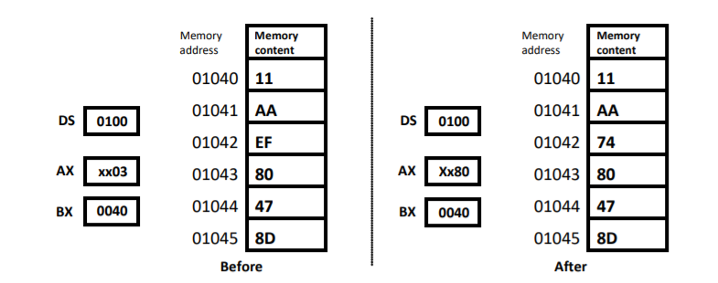
Example : For the figure below, what is the result of executing the following instruction?
XLAT

Slide 10
PUSH AND POP
Program Stack
PUSH & POP instructions

Slide 11
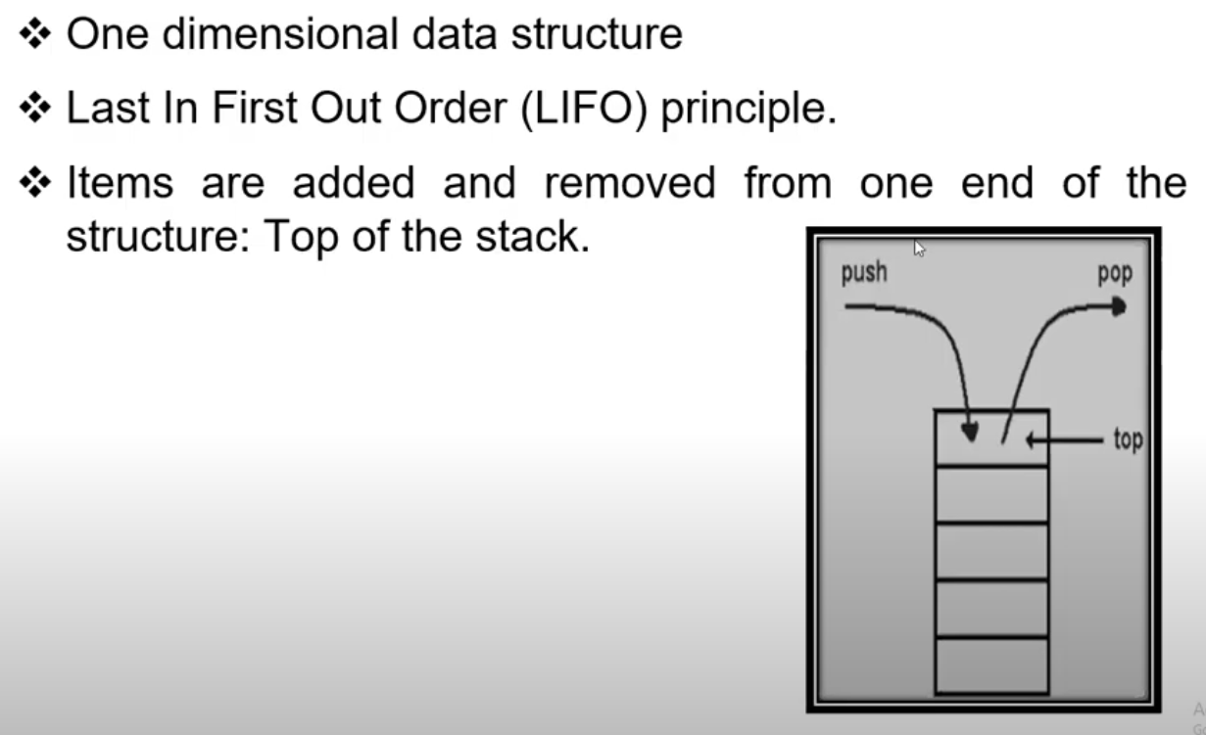
STACK

Slide 12
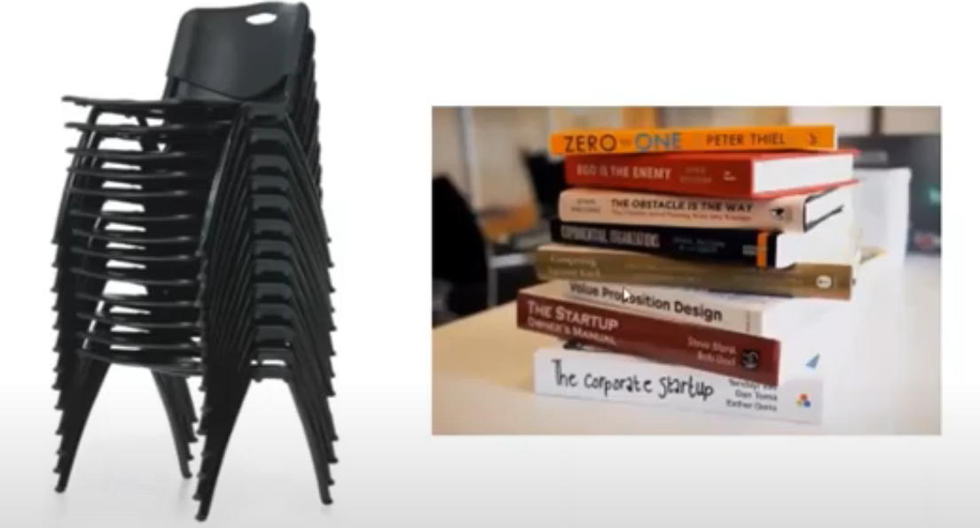
STACK

Slide 13
Stack Characteristics
Used to store temporary data during program execution
One point of access - the top of the stack
A stack is always operated as Last-In-First-Out (LIFO) storage, i.e., data are retrieved in the reverse order to which they were stored
Instructions that directly manipulate the stack
PUSH - place element on top of stack
POP - remove element from top of stack

Slide 14
Stack Implementation in Memory
Original SP
In Use
Stack grows in
direction
of decreasing
memory
addresses
In Use
In Use
Direction of
increasing
memory
addresses
In Use
In Use
In Use
SS:SP
FREE
FREE
FREE
FREE
SS

Slide 15
Stack Implementation in Memory (cont.)
SS - Stack Segment
SP initially points to top of the stack (high memory address).
SP decreases as data is PUSHed
PUSH AX ==> SUB SP, 2 ; MOV [SS:SP], AX
SP increases as data is POPed
POP AX ==> MOV AX, [SS:SP] ; ADD SP, 2
BP (base pointer) can point to any element on the stack

Slide 16
PUSH Instruction Example
To
address
12FFF
Register Array
PUSH BX
03800
AX
6A
037FF
BX
6AB3
6AB3
B3
037FE
CX
DX
SP Before PUSH BX
SP After PUSH BX
SP
0800
SS
0300
03000
STACK segment

Slide 17
POP Instruction Example
To
address
0FFFF
Register Array
01008
AX
POP BX
39
01007
BX
392F
392F
2F
01006
CX
DX
SP After POP BX
SP Before POP BX
SP
1006
SS
0000
00000
STACK segment

Slide 18
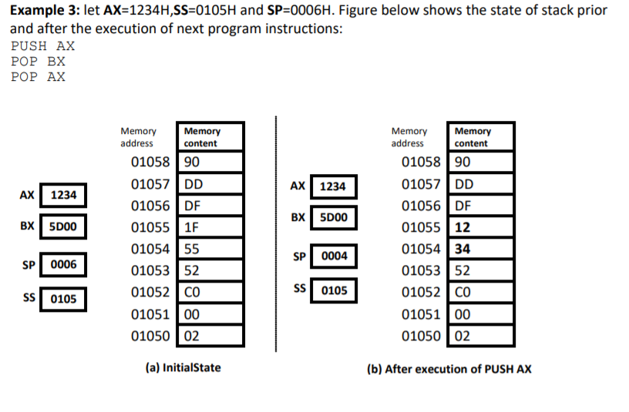

Slide 19
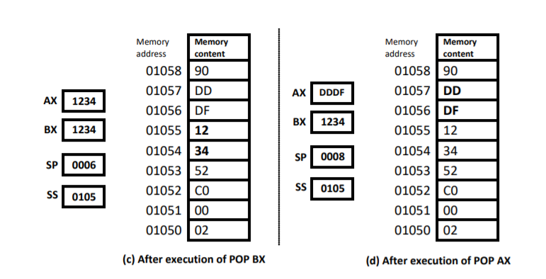

Slide 20
The Stack Use
To store
registers
return address information while procedures are executing
local variables that procedures may require

Slide 21
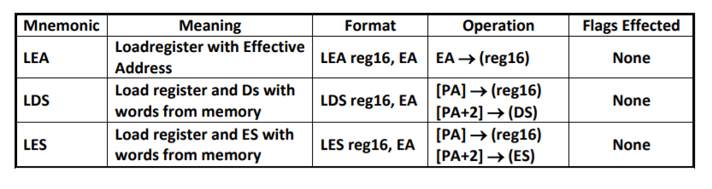
LEA, LDS, LES INSTRUCTIONS

Slide 22
LEA Register, Src:
It loads a 16-bit register with the offset address of the data specified by the Src.
E.g.: LEA BX, [DI]
This instruction loads the contents of DI (offset) into the BX register.

Slide 23
LDS Des, Src:
It loads 32-bit pointer from memory source to destination register and DS.
The offset is placed in the destination register and the segment is placed in DS.
To use this instruction the word at the lower memory address must contain the offset and the word at the higher address must contain the segment.
E.g.: LDS BX, [0301 H]

Slide 24
LES Des, Src:
It loads 32-bit pointer from memory source to destination register and ES.
The offset is placed in the destination register and the segment is placed in ES.
This instruction is very similar to LDS except that it initializes ES instead of DS.
E.g.: LES BX, [0301 H]

Slide 25
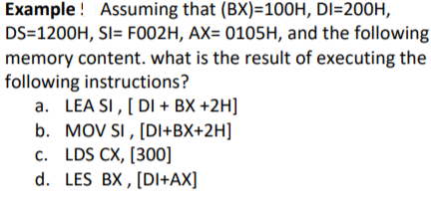
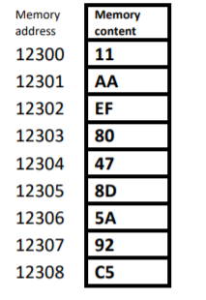
EXAMPLE

Slide 26
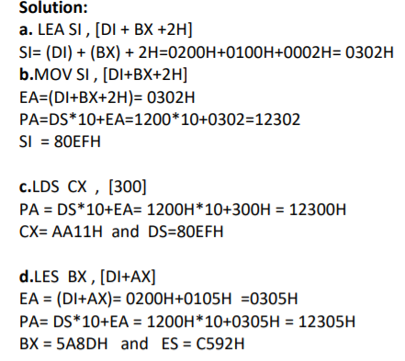

Slide 27
IN and OUT INSTRUCTIONS
IN Accumulator, Port Address:
It transfers the operand from specified port to accumulator
register.
E.g.: IN AX, 0028 H
OUT Port Address, Accumulator:
It transfers the operand from accumulator to specified port.
E.g.: OUT 0028 H, AX

Slide 28
LAHF, SAHF, PUSHF, POPF
LAHF:
It copies the lower byte of flag register to AH.
SAHF:
It copies the contents of AH to lower byte of flag register.
PUSHF:
This instruction decrements the SP by 2 and copies the word in flag register to the memory location pointed to by SP.
POPF –
Pop word from top of stack to flag - register. This instruction copies a word from the two memory location at the top of the stack to flag register and increments the stack pointer by 2..

Slide 29
Arithmetic Instructions
ADD DEC AAM
• ADC NEG DIV
• INC CMP IDIV
• AAA AAS AAD
• DAA DAS CBW
• SBB MUL CDW
• SUB IMUL

Slide 30
ADD
ADD Des, Src:
It adds a byte to byte or a word to word.
The source may be an immediate number, a register, or a memory location. The destination may be a register or a memory location. The source and the destination in an instruction cannot both be memory locations
It effects AF, CF, OF, PF, SF, ZF flags.
E.g.:
ADD AL, 74H
ADD DX, AX
ADD AX, [BX]

Slide 31
ADC
ADC Des, Src:
It adds the two operands with CF.
It effects AF, CF, OF, PF, SF, ZF flags.
E.g.:
ADC AL, 74H
ADC DX, AX
ADC AX, [BX]

Slide 32
ADD AL,BL ; AL=AL+BL
ii) ADD CX,DI ; CX=CX+DI
iii) ADD CL,44H ; CL=CL+44H
iv) ADD BX,245FH ; BX=BX+245FH
v) ADD [BX],AL ; AL adds to the byte contents of the data segment memory location addressed by BX with the sum stored in the same memory location
vi) ADD CL,[BP] ;The byte contents of the stack segment memory location addressed by BP add to CL with the sum stored in CL
vii) ADD CL,TEMP ;The byte contents of data segment memory location TEMP add to CL with the sum stored in CL viii) ADC AL,AH ; AL=AL+AH+carry
ix) ADC CX,BX ; CX=CX+BX+carry

Slide 33
SUB Des, Src:
These instructions subtract the number in some source from the number in some destination and put the result in the destination.
It subtracts a byte from byte or a word from word.
If you want to subtract a byte from a word, you must first move the byte to a word location such as a 16-bit register and fill the upper byte of the word with 0’s
It effects AF, CF, OF, PF, SF, ZF flags.
For subtraction, CF acts as borrow flag.
Ex:
SUB CX, BX CX – BX; Result in CX ➢
SBB CH, AL Subtract content of AL and content of CF from content of CH. Result in CH
SUB AX, 3427H Subtract immediate number 3427H from AX
SBB BX, [3427H] Subtract word at displacement 3427H in DS and content of from BX

Slide 34
SBB
SBB Des, Src:
It subtracts the two operands and also the borrow from the result.
It effects AF, CF, OF, PF, SF, ZF flags.
E.g.:
SBB AL, 74H
SBB DX, AX
SBB AX, [BX]

Slide 35
Multiplication
Only modern microprocessor contain multiplication and division instruction. Earlier 8-bit microprocessor could not multiply or divide without the use of a program that multiplied or divided by using a series of shifts and addition or subtractions. Because microprocessor manufacturers were aware of this inadequacy, they incorporated multiplication and division instructions into the instruction sets of the newer microprocessors
Note:
Mulplication is performed on bytes or words
The product after a multiplication is always a double-width product. If two 8-bit numbers are multiplied they generate a 16-bit product. If two 16-bit numbers are multiplied, they generate a 32bit product.
Some flag bits [overflow (O) and carry (C) ] change when the multiply instruction executes and produce predictable outcomes

Slide 36
MUL
The multiplication instruction contains one operand because it always multiplies the operand times the contents of AL
i) MUL CL ; AL is multiplied by CL and the unsigned product is in AX
ii) MUL BYTE PTR [BX] Multiply AL with byte in DS pointed to by [BX]

Slide 37
Example
Write a short instruction to multiply the content of BL and CL. Load BL
with 5, CL with 10. Store the result in DX register.
MOV BL,5
MOV CL,10
MOV AL,CL
MUL BL
MOV DX,AX

Slide 38
16-bit Multiplication
AX contains the multiplicand instead of AL
The 32-bit product appears in DX-AX instead of AX
DX register contains the Most Significant 16 bits of the product
AX contains the Least Significant 16 bits
MUL CX
; AX is multiplied by CX and the unsigned
product is in DX-AX
Note:
8086/8088 microprocessors can not perform immediate multiplication

Slide 39
IMUL-IMUL source
This instruction multiplies a signed byte from source with a signed byte in AL or a signed word from some source with a signed word in AX.
When a byte from source is multiplied with content of AL, the signed result (product) will be put in AX. When a word from source is multiplied by AX, the result is put in DX and AX
If the magnitude of the product does not require all the bits of the destination, the unused byte / word will be filled with copies of the sign bit, then CF and the OF will both be 0; If it contains a part of the product, CF and OF will both be 1.

Slide 40
IMUL-IMUL source
If the upper byte of a 16-bit result or the upper word of a 32-bit result contains only copies of the sign bit (all 0’s or all 1’s), then CF and the OF will both be 0; If it contains a part of the product, CF and OF will both be 1
AF, PF, SF and ZF are undefined after IMUL.
IMUL BH ; Multiply signed byte in AL with signed byte in BH; result in AX.
IMUL AX ;Multiply AX times AX; result in DX and AX
.

Slide 41
IMUL-IMUL source
If you want to multiply a signed byte with a signed word, you must first move the byte into a word location and fill the upper byte of the word with copies of the sign bit. If you move the byte into AL, you can use the CBW instruction to do this.
MOV CX, MULTIPLIER ; Load signed word in CX
MOV AL, MULTIPLICAND ;Load signed byte in AL
CBW ;Extend sign of AL into AH
IMUL CX ;Multiply CX with AX; Result in DX and A

Slide 42
Division
Division occurs on 8-or 16-bit numbers
The dividend is always a double-width dividend that is divided by the operand
This means that an 8-bit division divides a 16-bit number by an 8-bit number; a 16-bit division divides a 32-bit number by a 16-bit number

Slide 43
Division
Division occurs on 8-or 16-bit numbers
The dividend is always a double-width dividend that is divided by the operand
This means that an 8-bit division divides a 16-bit number by an 8-bit number; a 16-bit division divides a 32-bit number by a 16-bit number

Slide 44
8-bit Division
An 8-bit division uses the AX register to store the dividend that is divided by the contents of any 8-bit register or memory location
The quotient moves into AL after division with AH containing a whole number remainder
Zero-extension is needed in 8-bit division
DIV CL ; AX is divided by CL; the unsigned quotient is in AL and the
remainder is in AH
IDIV BL ; AX is divided by BL; the signed quotient is in AL and the signed
remainder is in AH
Example 5-14
Divide number 32 by number 64. Store the quotient at [2000] and
remainder at [2001] offset address.
MOV AL,64
MOV AH,0
MOV CL,32
DIV CL MOV[2000],AL
MOV [2001],AH

Slide 45
16 bit division
DIV CX ; DX-AX is divided by CX and the unsigned quotient is in AX and unsigned remainder is in DX
IDIV BX;DX AX is divided by BX; the signed quotient is in AX and signed remainder is in DX.
Example :
-100 is in AX. Divide by +9 in CX register
Solution:
MOV AX, -100
MOV CX, 9
CWD CWD convert word to double word
(i.e -100 in AX is converted to -100 in DX-AX)
IDIV CX

Slide 46
INC Src: INC reg/mem
It increments the byte or word by one.
The operand can be a register or memory location.
It effects AF, OF, PF, SF, ZF flags.
CF is not effected.
E.g.: INC AX

Slide 47
DEC Src: DEC reg/mem
It decrements the byte or word by one.
The operand can be a register or memory location.
It effects AF, OF, PF, SF, ZF flags.
CF is not effected.
E.g.: DEC AX

Slide 48
CMP Des, Src:
It compares two specified bytes or words.
The Src and Des can be a constant, register or memory location.
Both operands cannot be a memory location at the same time.
The comparison is done simply by internally subtracting the source from destination.
The value of source and destination does not change, but the flags are modified to indicate the result

Slide 49
CMP
CMP CL,BL
CMP AX,SP
CMP [DI],CH
CL-BL
; AX-SP
; CH subtracts from the byte contents of the data segment memory location addressed by DI

Slide 50
ASCII Airthmetic
ASCII arithmetic instructions function with coded numbers, value 30H to 39H for 0–9.
• Four instructions in ASCII arithmetic operations:
• AAA (ASCII adjust after addition)
• AAD (BCD to binary convert before division)
• AAM (BCD adjust after multiplication)
• AAS (ASCII adjust after subtraction)
• These instructions use register AX as the source and as the destination.

Slide 51
Packed & Unpacked BCD Numbers
Packed
AL = 59 Packed BCD Numbers
One Nibble Represents one BCD Digit
• Unpacked
• AL = 09
• One Byte Represents one BCD Digit

Slide 52
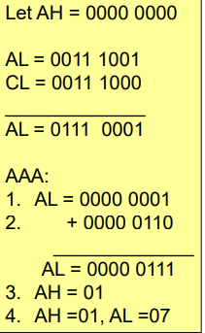
AAA
1.This instruction converts ASCII sum into unpacked BCD numbers after addition.
Valid BCD numbers are 0-9.
Invalid BCD numbers are A-F
• AL = 39H = BCD 9; CL = 38H = BCD 8
• ADD AL,CL = 71H

Slide 53
ALGORITHM
It works according to the following algorithm:
If lower nibble of AL>9 or AF=1 then:
AL=AL+6
Clear upper nibble of AL
AH=AH+1; Assume AH=0

Slide 54
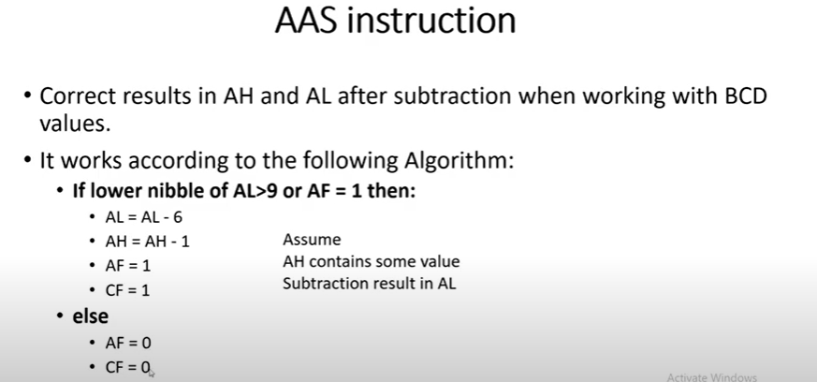

Slide 55
MOV AL, 38H
MOV BL, 36H
SUB AL,BL
AAS ; CONVERTS UNPACKED BCD IN AX INTO BINARY IN AX
MOV AL, 36H
MOV BL, 38H
SUB AL,BL
AAS ; CONVERTS UNPACKED BCD IN AX INTO BINARY IN A

Slide 56
AAM
This instruction converts the product after multiplication into unpacked BCD
Two operands should be unpacked bcd numbers
Final result after multiplication in AX register

Slide 57
AAM Instruction:
It is followed after Multiplication
Example :
MOV AL,5 MOV CL,3 MUL CL AAM
;load multiplicand
;load multiplier
;multiply
; adjust
After multiplication result in AX is 0105

Slide 58
AAD (BCD to binary convert before division)
This instruction converts two unpacked BCD digits in AL and AH registers to equivalent binary number in AL.
This instruction is used before divison operation.

Slide 59
AAD
Example:DIVIDE 48 by 4
MOV AL,08
MOV AH.04
MOV DL,04
AAD ; After this [AL]=30 H
DIV DL
AAA
Result AL=01H
AH=02H

Slide 60
Bit Manipulation Instructions
These instructions are used at the bit level.
These instructions can be used for:
Testing a zero bit
Set or reset a bit
Shift bits across registers

Slide 61
NOT Src:
It complements each bit of Src to produce 1’s complement of the specified operand.
The operand can be a register or memory location

Slide 62
AND Des, Src:
It performs AND operation of Des and Src.
Src can be immediate number, register or memory location.
Des can be register or memory location.
Both operands cannot be memory locations at the same time.
CF and OF become zero after the operation.
PF, SF and ZF are updated.

Slide 63
OR Des, Src:
It performs OR operation of Des and Src.
Src can be immediate number, register or memory location.
Des can be register or memory location.
Both operands cannot be memory locations at the same time.
CF and OF become zero after the operation.
PF, SF and ZF are updated

Slide 64
XOR Des, Src:
It performs XOR operation of Des and Src.
Src can be immediate number, register or memory location.
Des can be register or memory location.
Both operands cannot be memory locations at the same time.
CF and OF become zero after the operation.
PF, SF and ZF are updated.

Slide 65
Basic Logic Instructions
AND:
AND AL,BL ; AL=AL and BL
AND CX,DX ; CX=CX and DX
AND CL,33H ; CL=CL and 33H
OR:
i)
ii) iii)
XOR:
i)
ii)
iii)
TEST:
OR AH,BL ; AH=AH or BL OR SI,DX ; SI=SI or DX
OR SP,990DH ; SP=Sp or 990DH
XOR CH,DL ; CH=CH xor DL
XOR DI,BX ; DI=DI xor BX
XOR AH,0EEH ; AH=AH xor EEH
The TEST instruction performs the AND operation. The difference is that the AND instruction changes the
destination operand, whereas the TEST instruction does not.
TEST DL,DH ; DL is ANDed with DH TEST CX,BX ; CX is ANDed with BX
i)
ii)
NOT and NEG:
NOT CH ; CH is one’s complemented
NEG CH ; CH is two’s complemented
NEG AX ; AX is two’s complemented

Slide 66
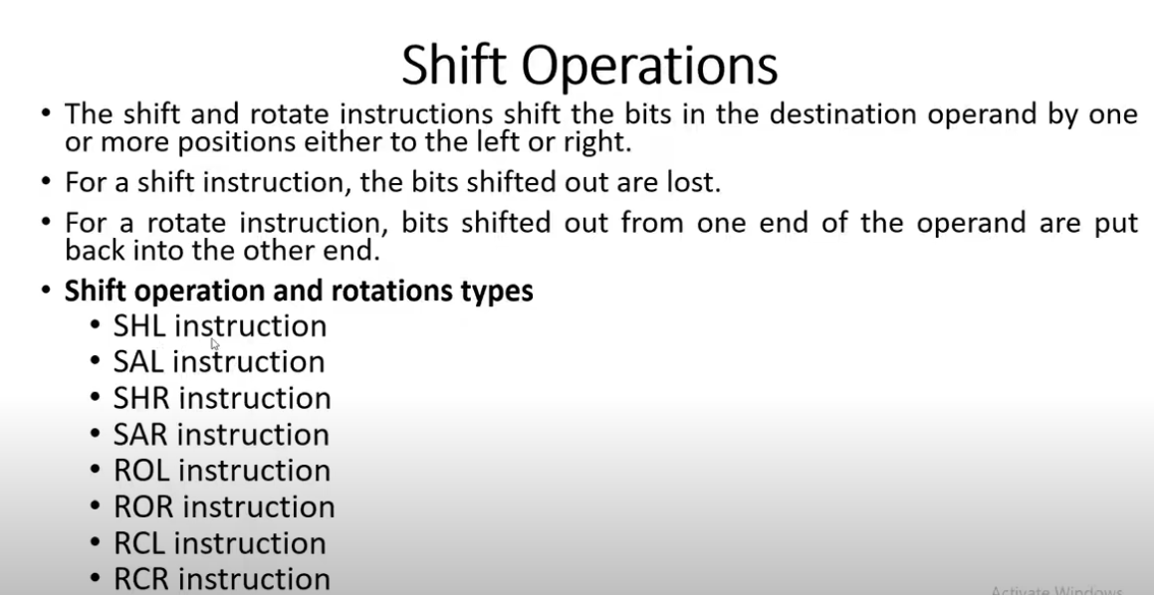

Slide 67
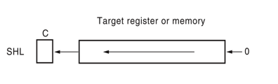
SHL/SAL Shift Logical/Airthmetic left
SHL Des, Count:
It shift bits of byte or word left, by count.
It puts zero(s) in LSBs.MSB is shifted into carry flag.
If the number of bits desired to be shifted is 1, then the immediate number 1 can be written in Count .Ex SHL BL,1
However, if the number of bits to be shifted is more than 1, then the count is put in CL register. Ex.MOV CL,2
SHL BX,CL

Slide 68

SHR Shift logical right
SHR Des, Count:
It shift bits of byte or word right, by count.
It puts zero(s) in MSBs.
LSB is shifted into carry flag.
If the number of bits desired to be shifted is 1, then the immediate number 1 can be written in Count.
However, if the number of bits to be shifted is more than 1, then the count is put in CL register.

Slide 69
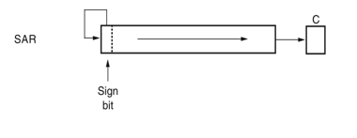
SAR Shift arithmetic right
SHR Des, Count:
It shift bits of byte or word right, by count.
It puts the MSB of the operand in the newly inserted position(s) in MSBs.
LSB is shifted into carry flag.
If the number of bits desired to be shifted is 1, then the immediate number 1 can be written in Count.
However, if the number of bits to be shifted is more than 1, then the count is put in CL register.

Slide 70
Shift and Rotate Instructions
SHL AX,1
SHR BX,2
SAR SI,2
; AX is logically shifted left 1 place
; BX is logically shifted right 2 places
; SI is arithmetically shifted right 2 places
Note:
The arithmetic left shift and logical left shift are identical
The arithmetic right shift and logical right shift are different because the arithmetic right shift copies the sign-bit through the number, whereas the logical right shift copies a 0 through the number
Segment register cannot be shifted

Slide 71
Rotate:
Rotate instructions position binary data by rotating the information in a register or memory location, either from one end to another or through the carry
ROL SI,1
RCR AH,CL
; SI rotates left 1 place
; AH rotates right through carry the number of places specified by CL

Slide 72

ROL Des, Count(Rotate left without carry)
It rotates bits of byte or word left, by count.
MSB is transferred to LSB and also to CF.
If the number of bits desired to be shifted is 1, then the immediate number 1 can be written in Count.
However, if the number of bits to be shifted is more than 1, then the count is put in CL register

Slide 73

ROR Des, Count: (Rotate right without carry)
It rotates bits of byte or word right, by count.
LSB is transferred to MSB and also to CF.
If the number of bits desired to be shifted is 1, then the immediate number 1 can be written in Count.
However, if the number of bits to be shifted is more than 1, then the count is put in CL register.

Slide 74
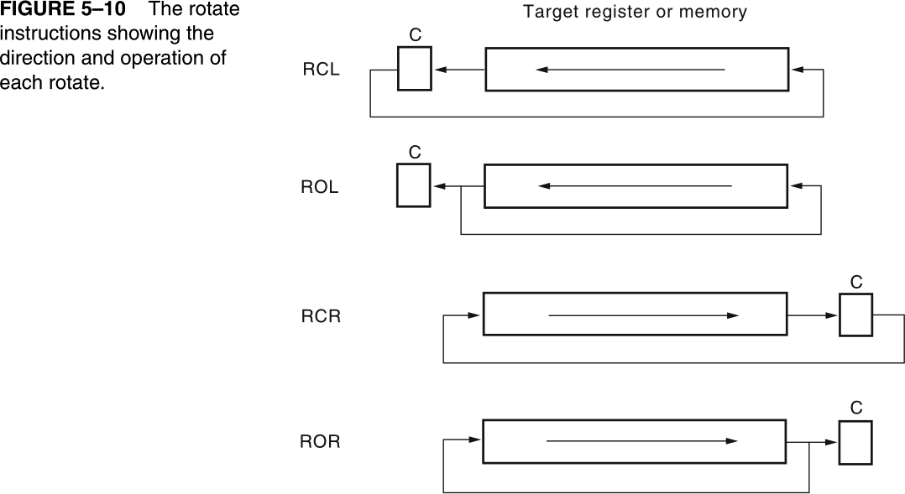

Slide 75
CBW and CWD
CBW (Convert Byte to Word):
This instruction converts byte in AL to word in AX.
The conversion is done by extending the sign bit of AL throughout AH.
CWD (Convert Word to Double Word):
This instruction converts word in AX to double word in DX : AX.
The conversion is done by extending the sign bit of AX throughout DX.

